Slide 1
Infancy and Childhood Development
Alla Greben
Maria Anakotta
Eric Huenefeld

Slide 2
Developmental Theorists
Sigmund Freud
Jean Piaget
Erik Erikson

Slide 3
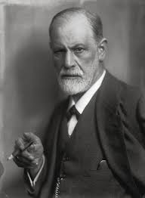
Sigmund Freud

Slide 4
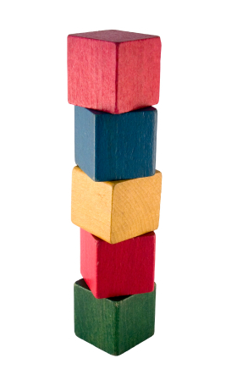
Sigmund Freud 1856-1939
5 Stages of Psychosexual Development
How personality develops during childhood

Slide 5
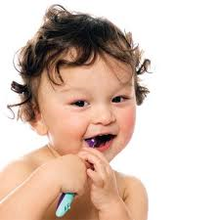
Stage 1: The Oral Stage
Birth to 1 year
Erogenous Zone: Mouth
Primary source of interaction is through mouth
Rooting & Sucking
Pleasure is found through tasting and sucking
Develops a sense of trust & comfort through oral stimulation
Child needs to become independent or will have dependency/ aggression issues
Oral fixation= drinking, eating, smoking, or nail biting problems

Slide 6
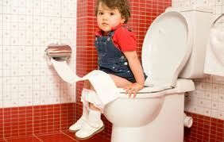
Stage 2: The Anal Stage
Erogenous Zone: Bowel & Bladder Control
1-3 years
Major focus of libido was on bladder & bowel control
Toilet Training Conflict
Praise & rewards for toilet training
Positive experiences=becoming competent, productive & creative adults
Inappropriate response lead to negative outcomes
Too lenient parent means anal-expulsive personality (messy, wasteful or destructive personality)
Too strict or too early training leads to stringent, orderly, rigid & obsessive personality

Slide 7
Stage 3: The Phallic Stage
Erogenous Zone: Genitals
3-6 years
Child begins to discover differences between males and females
Boys begin to view their fathers as a rival for mother’s affections.
The Oedipus complex describes these feelings of wanting to possess the mother and the desire to replace the father.
child also fears punishment by the father for these feelings, a fear termed castration anxiety.
Electra Complex is for same feelings from girls (penis envy)

Slide 8
Stage 4: The Latent Period
Erogenous Zone: Sexual feeling are inactive
6 to puberty
Interests are suppressed
Development of ego and superego
Enter school & get concerned with peer relationships, hobbies, & other interests
Time of exploration where sexual energy is present in intellectual pursuits & social interactions
Important in development of social & communication skills & self-confidence

Slide 9
Evaluating Freud’s Psychosexual Stage Theory
Theory is focused almost entirely on male development
The theories are difficult to test scientifically
Future predictions are too vague
Freud's theory is based upon case studies and not empirical research.

Slide 10
Jean Piaget Swiss Psychologist 1896-1980

Slide 11
Piaget’s Theory
Key Concepts
*Schemas
How kids understand and know the world
*Assimilation
How kids take in new information
*Accommodation
Changes or alters existing schemas for new information
*Equilibration
Balance between assimilation and accommodation

Slide 12
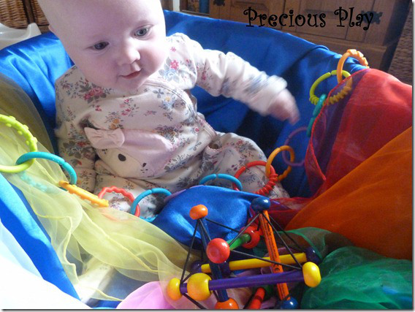
Sensorimotor Stage Birth – 2 Years Textures, sounds and colors are extremely attractive to babies Infants explore with all their senses

Slide 13
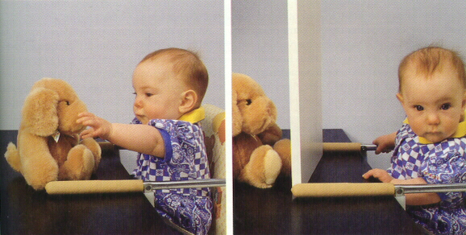
Object Permanence early in the Sensorimotor Stage
Child is unable to figure out where the hidden object is and forgets about the object if he or she cannot see it anymore.

Slide 14
https://www.youtube.com/watch?v=PuP53BbIY0A

Slide 15
Object Permanence

Slide 16
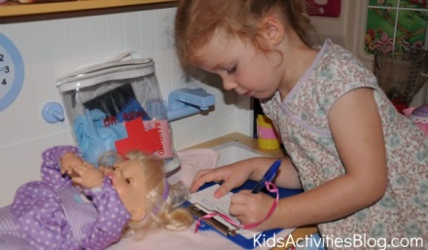
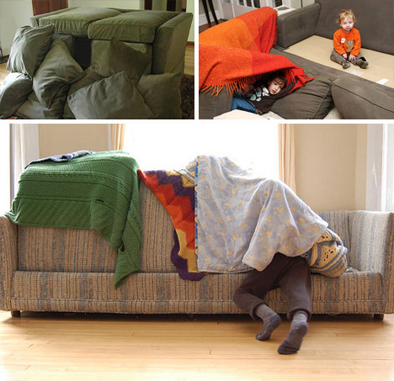
Preoperational Stage 2 years – 7 years
Vocabulary use explodes
Children use symbolic play

Slide 17
Piaget’s Conservation Task Most kids in the Preoperative Stage cannot reason that the amount of water is the same, the only change is the shape of the vessel.

Slide 18
Concrete Operational Stage 7 years – 11 years

Slide 19
Pros and cons for Piaget’s Theory of Cognitive Development
Pros
His insight has proven to be practical and on point in many case.
His theory has changed how people view kids’ development and their approaches to teaching.
Cons
His research came from a very small sample (his own children and a few others).
His methods are open to bias since they are his own interpretations.

Slide 20
Erik Erikson June 15, 1902-May 12, 1994
Retrieved from nursingcrib.com/nursing-notes-reviewer/psychiatric-mental-health-nursing/erik-eriksons-theory-of-psychosocial-development/

Slide 21
Erikson’s Theory of Development
Best known at Psychosocial Development
Stages go from Birth through Adulthood
Adolescence crucial in child’s development

Slide 22
Stage 1: Trust vs. Mistrust

Slide 23
Stage 2: Autonomy vs. Shame

Slide 24
Stage 3: Initiative vs. Guilt

Slide 25
Stage 4: Competence vs. Inferiority

Slide 26
Sources
Cherry, K. (2013). About.com Psychology: Freud & Women: Freud's Perspective on Women. Retrieved from http://psychology.about.com/od/sigmundfreud/p/freud_women.htm
Sigmund Freud. (2013). The Biography Channel website. Retrieved 07:58, Nov 5, 2013, from http://www.biography.com/people/sigmund-freud-9302400.
Cherry, K. (2013). About.com Psychology: Freud's Stages of Psychosexual Development. Retrieved from http://psychology.about.com/od/theoriesofpersonality/ss/psychosexualdev.htm
Sigmund Freud. Retrieved from http://en.wikipedia.org/wiki/Sigmund_Freud
Building Blocks Stages. Retrieved from http://www.clearviewtreatment.com/wp-content/blogs.dir/12/files/2013/07/5-stages-addiction.jpg
Child with Toothbrush. Retrieved from http://www.dentalolujic.it/ultime-novita/notizie/
Potty Training Child. Retrieved from http://9eraiherbal.blogspot.com/2013/02/sembelit-pada-anak.html
Bathroom sign. Retrieved from http://viewfromthehandicappedspace.blogspot.com/2011/06/for-handicapped-bathroom-suggestion-box.html
Children standing together. Retrieved from http://www.360doc.com/content/12/0822/18/3404269_231761903.shtml

Slide 27
McLeod, S. A. (2009). Jean Piaget: Cognitive theory. Retrieved from http://www.simplypsychology.org/piaget.html
Hockenbury, D., &Hockenbury, S. (2011). Lifespan development Discovering psychlogy (5th ed.). New York, NY: Worth Publishers.
Edwards, L., Hopgood, J., Rosenberg, K., & Rush, K. (2000).Mental development and education: Piaget's stages of cognitive development. Retrieved from http://ehlt.flinders.edu.au/education/DLiT/2000/Piaget/stages.htm
[Babies with book]. Retrieved from http://3.bp.blogspot.com/-OsvmcWZmF5k/UGN5z84j5kI/AAAAAAAACss/swUzz-r4U1Q/s320/babies+with+book.jpg
[Object permanence]. Retrieved from http://www.babiescantwait.com/?attachment_id=512
[Baby color sensory bath]. Retrieved from http://preciousplay.wordpress.com/2013/07/23/baby-colour-sensory-bath/
[Three mountain test]. Retrieved from http://childdevelopment-bo.blogspot.com/
[Pillow fort architects]. Retrieved from http://dornob.com/pillow-fort-architects-10-sofa-sheet-cushion-structures/#axzz2jX5g8SRl
[Piaget with children]. Retrieved from http://www.famouspsychologists.org/jean-piaget/
[Object permanence baby and teddy bear]. Retrieved from http://cmapsinternal.ihmc.us/rid=1051885971740_1865133171_12193/Development
[Little girl plays doctor]. Retrieved from http://kidsactivitiesblog.com/15772/pretend-play-make-a-play-doctors-kit
[Boy three mountain test]. Retrieved from http://www.realmagick.com/egocentrism/
[Piaget's conservation task]. Retrieved from http://peoplelearn.homestead.com/RESEarch/THREE2.html
[Conservation beans]. Retrieved from http://www.psychologytoday.com/blog/thinking-about-kids/201110/pirates-piaget-and-the-null-hypothesis
Jeningh (2007, February 11). Object permanence 2. [Online video]. Retrieved from http://www.youtube.com/watch?v=NjBh9ld_yIo
Jeningh (2007, February 11). Object permanence 2. [Online video]. Retrieved from http://www.youtube.com/watch?v=NjBh9ld_yIo

